Slide 1
Shopee Xpress Product Architecture
Master file

Slide 2
Agenda
1. SPX Product Architecture Overall
2. SPX Sub Product Architecture
Product & Order
Product
Order (including Tracking)
Network & Dispatch & Exception
Operation
Pickup
In-Station
Line haul
Delivery
Service Point
Locker
Resource Mgmt
Workforce
Asset
Vehicle
Data & Algo
Smart Solution
Data Product
Finance
COD
Basic Service
Account
Notification
Container

Slide 3
Shopee Supply Chain Product Relationship Overall
BR Market
SEA+TW Market
Shop
Seller
(SellerCenter)
User
Listing
Order
FBS
Open API
MyStock
Retail
Open
ISV
(MyStock)
SPX Open
MyStock
Supplier Center
PMS
-Retail
SPX Open
Merchant
Open API
Fulfillment
Logistics
2B Fulfillment
2C Fulfillment (OMS)
SLS
ISC
Local订单履约服务
CB订单履约服务
PIS
WMS/TWS/SPX + 3PL
Onground System
WMS
SPX
3pl
FM
TWS
LH
CC
LM
Data & Finance

Slide 4
The Whole Picture for Shopee Logistics
Last modified: Nov 2022
Logistics Core System
LPS
Services
Multi-Product
CB Product | Local 3PL Masking
Single Product
Local C2C | Local B2C | CB Line-Haul
Basic Service
Tracking | AWB | Allocation | Time Estimation | ...
LFS
Logistics Order
Local Network
International Line-Haul Network
International Service
E-Booking | Customs Clearance | ...
LLS
Site / Line Resources
PIS (Partner Integration System)
ID
BR
…
Express
On-the-ground System
TWS
J&T
sys
Ninja
sys
Correios
sys
...

Slide 5
SPX Overall Product Architecture (As-is, Nov 2022)
Last modified: Nov 2022
Network
Planning
Order Center
Tacking Service
Order Processing
Operation Monitor
Tracking Service
Network Planning
Lead Time Planning
Dispatch Center
Event Center
Dispatch Strategy
Operation Plan Management
Event Center
Smart Solution
Operation Service Library
FM/LM Domain
In-station Domain
LH Domain
SP Domain
Locker Domain
Exception Domain
SLPS
Smart Sorting
Operation
Operation
Operation
Operation
Operation
Operation
Operation
Pick-up
Delivery
Inbound/Outbound
Packing
Parcel sweeping
ASM
LH Handover
Transportation
Drop-off Self-collection
Inventory Mgt
Drop-off
Self-collection
Driver operation
Task after the interception
Pickup
Smart Pickup
Smart Delivery
Management
Management
Management
Management
Management
Management
Management
Task Mgt
Pick-up Point Mgt
Task Mgt
LH Trip Mgt
LH Resource Mgt
Task Mgt
SP Partner Mgt
Locker Partner Mgt
Task Mgt
Task Mgt
Task Mgt
Supply Chain
Common Service
WFM & Driver Mgmt
General Service
Finance
Data/Algo
Driver
Workforce
COD
Wallet
Asset/ Vehicle
Basic
Account
Container
SEA+TW+LATAM Common
LATAM Exclusive
Supply Chain Common
Notes:
Task Mgt = planning (wave+shift) - assignment - execution, also including tools utilizing from the general service, e.g. smart sorting and routing etc.
WFM：Staff Mgt, Shift and Attendance Mgt, Performance/Compensation/Ranking (driver/operator may be different);
Exception: Dispute, Ticket, Lost/Damage, Interception, SLA exceeding, Off-line exception handling

Slide 6
SPX Overall Product Architecture Details (As-is, Nov 2022)
Last modified: Nov 2022
Network Planning
Order Center
Tracking Service
Operation monitor
Network Planning
Order Processing
Order Process
Order Process
SLS Integration
SPX Portal Integration
Tracking Config
Network Planning
Create Cancel
Reroute Update
Order Info Mgt Order Status Mgt
Order Account Fee trigger Mgt Tag Mgt
Operation Overview
Exception Monitor
Lead Time Planning
Dispatch Center
Event Center
Lead Time Planning
Dispatch Strategy
Operation Plan Management
Plan Push
Ops/Unsuccessful/4PL Event Receiving
Events Cleaning
Events Notification/Broadcast
Tech Exception Handling
Static Route Mgt
Dynamic Route Mgt
Event Trigger
Plan Creation
Smart Solution
Operation Service Library
Smart Sorting
FM/LM Domain
In-station Domain
LH Domain
SP Domain
Locker Domain
Exception Domain
SLPS
Driver Zone Definition
Sort Code Mapping
Operation
Operation
Operation
Operation
Operation
Operation
Operation
Smart Pickup
Pick-up
Delivery
Inbound/Outbound
Packing
Parcel sweeping
ASM
LH Handover
LH Trip
Drop-off
Self-Collection
Inventory Mgt
Drop-off
Self-collection
Driver operation
Task after the interception
Pickup
Pickup Zone Management
Smart Pickup Routing
Management
Management
Management
Management
Management
Management
Smart Delivery
Task Mgt
Pick-up Point Mgt
Task Mgt
LH Trip Mgt
LH Resource Mgt
Task Mgt
SP Partner Mgt
Task Mgt
Locker Partner Mgt
Task Mgt
Ticket Mgt
Management
Smart assignment / Driver scheduling
Parcel sequencing
Task Mgt
Supply Chain
Common Service
WFM & Driver Mgmt
General Service
Finance
Data/Algo
COD
Account
Container Service
Asset Mgmt
Vehicle Mgmt
shipping fee
Address Ability
Zone Management
Algo Service
Data Service
Manpower Planning
In-Station Labor Performance
Driver Performance
Driver Compensation
Driver Wallet
COD Collection/Settlement
Payment
Cash-In / e-Wallet
Staff Management
Shift/Attendance
Notification
Printing
Serviceable Area Mgmt
Basic
SEA+TW+LATAM Common
LATAM Exclusive
Supply Chain Common
Notes:
Task Mgt = planning (wave+shift) - assignment - execution, also including tools utilizing from the general service, e.g. smart sorting and routing etc.
WFM：Staff Mgt, Shift and Attendance Mgt, Performance/Compensation/Ranking (driver/operator may be different);
Exception: Dispute, Ticket, Lost/Damage, Interception, SLA exceeding, Off-line exception handling

Slide 7
SPX Overall Product Architecture (Long-term planning, updating)
SLS Product
(SPX产品服务)
SLS Order
(Shopee order/NNS)
Network & Routing
Order Center
Tacking Service
Order Account
（从网络中封装分层网络服务）
Order Processing
订单管理 + 主订单逻辑管控 + Exception处理和SLS交互
Tracking Service
Network Mgmt
空间/时间/容量
Order
Routing
路由规则
(静态/动态)
Dispatch Center
Event Center
Dispatch Strategy
正常配送场景 / Exception（截单/Lost） / 干线流量调拨…
Exception Monitor
Order的生命周期实时监控
Event Center
Operation Plan Management
跨域Operation Order结合的实时数据监控
Smart Solution
末端网络
Operation Service Library
SAAS化系统
FM/LM Domain
SP Domain
Locker Domain
In-station Domain
干线网络
LH Domain
Exception Domain
SLPS
Smart Sorting
Operation
Operation
Operation
Operation
Operation
Operation
Operation
Pick-up
Delivery
Drop-off Self-collection
Inventory Mgt
Drop-off
Self-collection
Driver operation
Inbound/Outbound
Packing
Parcel sweeping
ASM
LH Handover
Transportation
Task after the interception
Pickup
Smart Pickup
Smart Delivery
Management
Management
Management
Management
Management
Management
Management
Task Mgt
Pick-up Point Mgt
Task Mgt
SP Partner Mgt
Locker Partner Mgt
Task Mgt
Task Mgt
LH Trip Mgt
LH Resource Mgt
Task Mgt
Task Mgt
Supply Chain
Common Service
WFM & Driver Mgmt
Vehicle Mgmt
General Service
Data/Algo
Asset
Finance
Driver
Workforce
Vehicle
COD
Wallet
Basic
Account
Container`
人力规划
车辆规划
新增模块
新独立模块
外部支持
原有模块
SAAS
规划模块
（Nov. 22 version）

Slide 8
Agenda
1. SPX Product Architecture Overall
2. SPX Sub Product Architecture
Product & Order
Product
Order (including Tracking)
Network & Dispatch & Exception
Operation
Pickup
In-Station
Line haul
Delivery
Service Point
Locker
Resource Mgmt
Workforce
Asset
Vehicle
Data & Algo
Smart Solution
Data Product
Finance
COD
Basic Service
Account
Notification
Container

Slide 9
SPX Product & Order (1/3) - SPX Product
1. NSS和SPX order等下游之间的关系图，可以参考Page 21（WFM的关系图）
2. 业务视角更新一下 NSS的产品架构
https://docs.google.com/presentation/d/13d2DOuFG5tvSjMXeiV2Y5f3HkAiDWkXdCNJu9RlqUds/edit#slide=id.g13b3bb216be_1_346

Slide 10
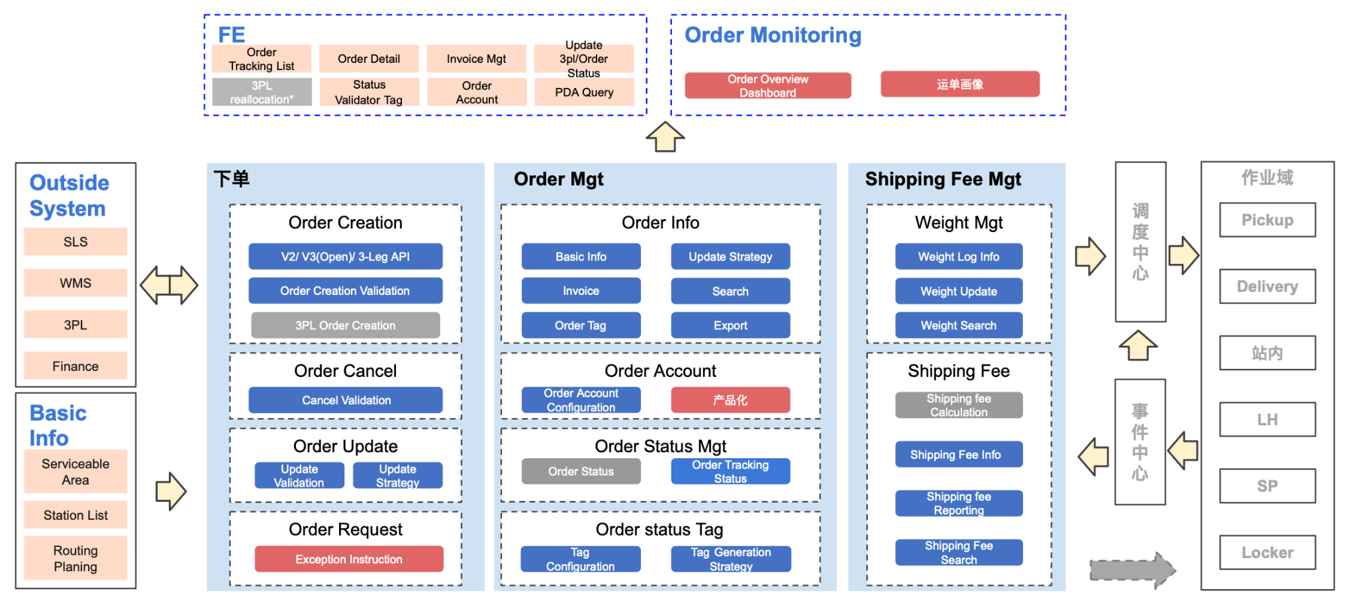
SPX Product & Order (2/3) - Order/Tracking

Slide 11
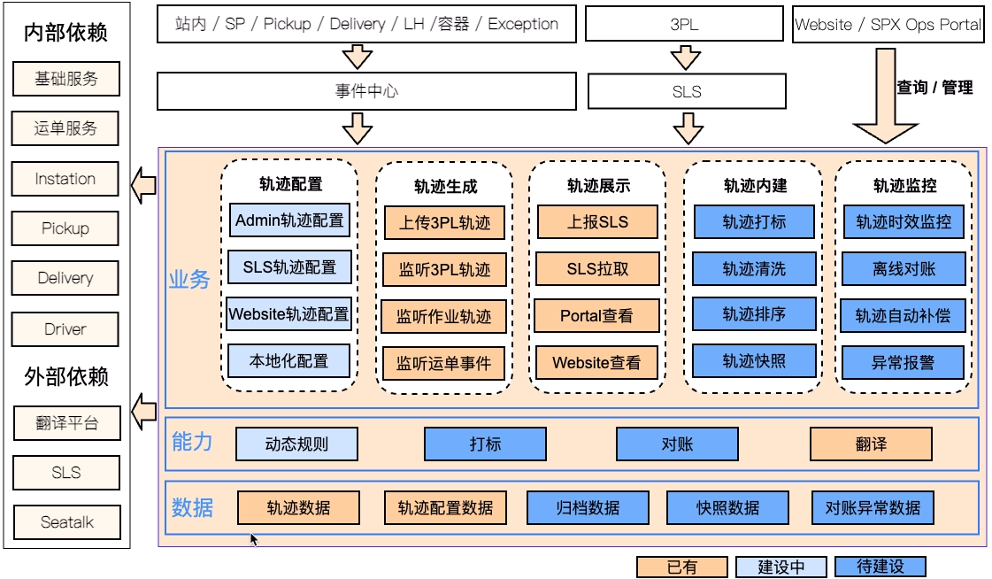
SPX Product & Order (2/3) - Order/Tracking

Slide 12
SPX Product & Order (1/3) - Network/Dispatch/Exception
Service
末端履约方案
订单路由时效
From — To
Origin Site -> LH Origin Site -> LH Dest Site -> Dest Site
Dest Site -> LH Dest Site -> LH Return Site -> Return Site
Sort Code
Pickup/Deliver/Return
WHS/Locker/SP
Origin Path
Forward/Return
Updated Path
Forward/Return
核心履约站点
Pickup Station / Deliver Station / Return Station / Handover Station / Dispose Station
SLA
时效承诺 / 延误定责 / 动态预警
Basic
网络管理
网络负载监控
网络推荐
网络编辑
网络发布
变更提醒
对外同步
站点/服务范围
负载情况
站点/线路
Serviceable Area
Routing Mgt
Solution计算策略
From-TO/核心履约站点/Sort Code
Connect Config
MM Route(线路配载) / 网络调优
路由最优策略
Origin Path
Updated Path
资源容量
站点/线路
White List
FM: PUP/Shop ID/ WHS
LM: 3PL/Reverse
Address Config
zone ID
lowest Address ID + Sort Code
MM Product
时效/经济 air/sea/land
Route Config
SLA/Type/Distance/Toll/Fuel
Site Mgt
建议
Ad-hoc Trip调整
基础信息管理
物流履约类：All mile Hub/FMHub/SOC/Hub
SP/Locker/PUP/WHS
资产管理类：Asset WHS
业务能力配置
AWB Support
Error Message Config
站点选址
依赖
Address
Smart Sorting
LH
In Station
Workforce
Event
L1-L4
Hub Zone
Schedule / Trip
Capacity
FM Shift
Postcode
货量热力分布
Trip Cost
Efficiency
LM Shift

Slide 13
SPX Product & Order (2/3) - Network/Dispatch/Exception
Event
Center
Order Center
Tracking Center
Exception Center
Network
Container
General Service
Business Scenario
Pick-up
Drop-off
Delivery
Self Collection
Cross Dock
XPT
… …
Strategy
Analysis
Monitor
Scenario Recognition
Fulfillment Rule Config
Operational Behavior Analysis
Event Listen
Status Change
E2E Plan Management
SLA Achievement Analysis
E2E Plan
SLA
Calculation
Resource Calculation
E2E Plan Calculation Log
Forward
Return
Dispose
Operation Plan Management
Operation Plan
Exception Plan
Plan Content Config
Pickup
In-station
LH
SP
Locker
Delivery
Intercept
Expedite
… …
Plan Push
Improving
Real-time Push
Re-push
Log
Alert
Planing
Operation Domain
Notes:
说明文档：Link

Slide 14
SPX Product & Order (2/3) - Network/Dispatch/Exception
Dispatch Center
Management Console
Operate Domain
Plan Query
Plan Ru-push Log Query
Plan Re-push Manually
Pickup
Event Center
In Station
Data Collection
Plan Management
Plan Push
Delivery
Event Listen
Conventional Plan
Pickup(6) | Delivery(2) |Return(3) | LH(1) | Handover(1) | Receive(9) | SP(4) | Locker(1)
Exception Handling Plan
Relabel(Instation,SP,Pickup,Exception)
FraudInterception (Instation,Exception)
LostInterception (Instation,Exception)
OtherPlan(4)
Real-time push
Return
Container Service
API Listen
Re-push
Line Haul
Order Center
Service Point
Timed pull
Create
Update
Processing
Completed
Ended
Canceled
Locker
Network
Cross-domain notification for no create plan
Basic Service
Processing(Compensate)
ServiceArea
Illustrate
to improve
exist
Strategy
Error Correction
Statistics
Notice
to add
not this domain
Orchestration Strategy
Plan error correction
Cross-domain handover quality statistics
Efficiency Notice
依赖链路
数据链路
‹#›

Slide 15
SPX Product & Order (3/3) - Network/Dispatch/Exception
Event
Center
Order Center
Tracking Center
Network
General Service
Business Scenario
Lost
Damage
Anti-Fraud
Duplicate Parcel
Buyer RR Approved
… …
Exception Identification
Recovery
Exception Monitoring
Exception Rule
Dispute Management
Event Listen
Exception Definition
Exception Reason Config
Interception Rule Config
Follow Up
Action Config
Create
Resolve
Exception Handling
Assign
Compensation Solution
Exception Order Management
Ticket Management
Communication
Rule Config
Create
(Manual / Auto)
Resolve
(Manual / Auto)
Cancel
(Manual / Auto)
Operation Log
Liquidation Management
Atom Service
Improving
Update Order Status
LM 3PL Reallocation
Update Destination
Update Dim-weight
Manual Upload
Interception
Update
Receiver Info
Planing
Dispatch Center
Exception Plan
Operation Domain
Exception Plan
Notes:
说明文档：Link

Slide 16
SPX Product & Order (3/3) - Network/Dispatch/Exception
Operate Client
Web Portal
PDA
Exception Center
Developing
SLS
Exception
Init
Operation
Management
Ticket
Mgt
Manual
Handling Tool
Dispute
Mgt
Statistic Analysis
Create / Cancel
Update
Status
Create /
Cancel
Improving
E2E
API
Create Exceptions
Report
Event Center
Event Listen
Operation
Solution
Confirm
3PL
Reallocation
Responsibility
Confirm
Planning
Dashboard
Cancel
Exceptions
Comment
Update
Destination
Comment
Notification
DatafixTool
Notification
Exception Basic Service
Exception Order
Handling Rule
Order Management
Operation History
Anti-Fraud
Relabel
Lost
Damage
Exceeded
Dimensions
Label Duplicity

Slide 17
Agenda
1. SPX Product Architecture Overall
2. SPX Sub Product Architecture
Product & Order
Product
Order (including Tracking)
Network & Dispatch & Exception
Operation
Pickup
In-Station
Line haul
Delivery
Service Point
Locker
Resource Mgmt
Workforce
Asset
Vehicle
Data & Algo
Smart Solution
Data Product
Finance
COD
Basic Service
Account
Notification
Container

Slide 18
SPX Operation (1/6) - FM Pick-up
Network
Planning
Order Center
Tracking Service
Dispatch Center
Event Center
FM Business Scenario
Other Operation Service Library
Implant Pickup
(Sea)
Normal Pickup
(Sea + BR)
Rescue Pickup
(Sea)
Merge Pickup and Return
(Sea)
FM Management
FM Operation
FM Monitoring
PUP Group Management
Pickup Route Management
Pickup Wave Management
Ops Pickup Task/Trip Operations
Driver Pickup Operations
Driver Handover Operations
Live Dashboard
Manual Route
Pickup Fail Mgt
Manual Group
Pickup Window
Handover by Task
Routeasy
Manual Task Creation
Sea
Normal Task Auto Accept
Weigh Parcel
Smart Pickup
(Driver Zone)
Pickup Wave
Handover by Order
Inhouse Smart Route
Pickup Task Assignment
Quick Pickup Task
ASF Collection
Handover to Driver
Pickup Point Management
Pickup Trip Assignment
Onhold Pickup Task
Onhold Parcel
BR
Handover to Station
PUP Hierarchy
Pickup Trip Reroute
Pickup Parcel
Pickup Proof
Pickup Task Disable
Handover Onhold
PUP Merge
PUP Distribution
PUP Pickup Timeslot
PUP Pickup
VehicleType
Sea
+BR
Onhold Task Reassignment
Handover
Proof
PUP Creation
Data & Algo & Finance
WFM
General Service
ASF
Shop Info
Existing
Developing
Planning
Notes:
2022-12-08 review
驻场：
后端接口性能、异步任务处理
TO打通，待对齐
暂时不会在Seller进行分拣（是否走虚拟一个SOC的点来集成sorting能力）
波次
timeslot
Quick Pickup
Pickup window时间段与商家可选的时间，目前两者是割裂的，可以讨论下如何打通，提升商家体验
Seller备货数据如何打通？有多种技术方案，如监听面单打印事件
图中两个Proof可以再具体一些
Seller 备货表现
卖家驻场的模式，后续是否会有sorting的诉求（可能需要考虑驻场的卖家占比、单量分布和sorting的诉求，这个可以反馈给BPM，他们来评估下，估计一期不会有，一起更多是跑通链路）；如果后续有，波哥的建议是虚拟一个soc来集成sorting的能力（也就是一个物流PUP同时具备PUP+SOC两个业务属性标签，不同业务属性标签来链接不同的系统能力，例如打TO、分拣等）
直接走quick Pickup而没有走task分配的模式，对整体的数据分析、定责管控、timeslot的管理会有挑战（也就是模式是不是可以统一？如果不能统一，这两种模式是否可以并行，但对于后续这些功能能做比较好的兼容。我个人的建议是，不要为了统一系统而强行改变用户习惯，如果用户quick pickup的作业效率高，那我们就产品适配用户习惯。这个可以和BPM一起讨论下，先不考虑产品先考虑实际场景）
pickup time在官网和实际作业的数据不一致（用户体验不好，这个是个小点，但可以优化；官网虽然流量低，但是门面和口碑的入口，有二级传播效应，所以尽量保持数据一致，这个不紧急）
Seller备货的场景，尽量FM闭环，不建议走Dispatch，这个后面有场景再聊（Dispatch更多调度的是业务模式，pickup更多是管理作业组合，备货的数据信息更多是FM信息处理的事情，和业务模式关系不大）
pickup wave后续的产品优化

Slide 19
SPX Operation (2/6) - InStation

Slide 20
SPX Operation (3/6) - LineHaul

Slide 21
SPX Operation (4/6) - LM Delivery
Network
Planning
Order
Tracking
Dispatch center
Event
Business Scenario
Other Operation Domain
Deliver to buyer
SEA+BR
Deliver to SP
SEA+BR
Deliver to Locker
SEA
Solution
Operation
Monitor
Auto AT Creation Rule
Assignment
Accept
Sequence
Delivery
Live Dashboard
Routing solution (BR)
Zone solution(SEA)
Auto creation
Accept by order
Sequence by routing service
Delivery location validation
Auto AT Assignment Rule
Manual creation
Accept by AT
Sequence by TN
Delivery address type collection
Driver-zone configuration (SG)
Auto assignment
Accept by TO
Handover validation
In-station support (BR)
Manual assignment
Accept validation(BR)
POD collection
Label printing validation
Corridor-cage allocation
Assignment validation(BR)
COD collection
Data&Algo&Finance
WFM
General service
COD
‹#›
Notes:
2022-12-08 review
1）solution模块交给站内，如何进行切分
2）不同场景的规则引擎，未来场景复杂后可考虑AT维度增加对应配置管理模块

Slide 22
SPX Operation (5/6) - Service Point
Client
For Partner
For Seller
For Buyer
SP Portal
SP APP
SPX Website
SPX Website
Check In Machine
Check In Machine
Payment Machine
商业
运营
Planning
Partner Management
Dropoff Service
In-Point Service
Collection Service
Heatmap
分布 | 策略
入驻
KYC | 审核 | 合同 | 培训
Normal Drop-off
Self
Drop-off
Put Away
Adjust Inventory
Normal Collection
Self
Collection
Performance
入库及时率 | 丢件率
Dropoff Inbound
Print Receipt
Pack TO
Unpack TO
Collection Inbound
Collection Outbound
Parcel
Weight
Pay Shipping Fee
Put Locker
Handover TO
Self Checkin
Self Payment
Recommend Potential Area
预测 | 策略
提成（BMS）
计费 | 转账
Print
Receipt
Print
AWB
Inventory Mgt
Complete TO
Send SMS
Collection Remind
附加服务
暂存 | 广告 | 零售
Checkin
Drop off Outbound
Parcel Search
Print Receipt
Point Service
Point Mgt | Zone Mgt | Checkout limitation
Account Service
Account Mgt | Role Mgt | Permission Mgt | Authentication
Monitor & Alert
超时未取预警 | 爆仓预警
Daily Reports | Dashboard
Existing
Planning
Notes:
2023.2.9 Review
1）KYC 入驻借用了open的能力，但跟Driver、Agence里面的入驻是独立建设，长远方案是否要统一 ？ @jing.wu ——按统一的方向走。
2）Point Service 是SP域内提炼的站点模型，继承了site

Slide 23
SPX Operation (5/6) - Service Point
Client
For Partner
For Seller
For Buyer
SP Portal/APP
SP Open API
SPX Website(KYC)
SPX Website(Find SP)
SP Portal(H5)
SPX Website(Find SP)
SP Portal(H5)
商业
运营
Partner Management
Drop-off Service
Collection Service
入驻
KYC | 审核 | 合同 | 培训
Shopee Drop-off
自助寄件 | 店员寄件
SP(Locker) collection
自助取件 | 店员取件
Non-Shopee Drop-off
Walk-in | ERP
VAS
COD | 包材回收
Performance
入库及时率 | 丢件率
提成（BMS）
计费 | 转账
VAS
上门取件 | 称重量方 | 退货免运
In-point Service
Check-in
Drop-off | Self-collection
TO packing
Inventory
Put-away | Parcel search | Cycle count
Point Service
Point Mgt | Zone Mgt | Checkout limitation
Account Service
Account Mgt | Role Mgt | Permission Mgt | Authentication
Monitor & Alert
超时未取预警 | 爆仓预警
Daily Reports | Dashboard
Existing
Planning
Notes:
VAS是物流VAS，还是平台盈利性收入

Slide 24
SPX Operation (6/6) - Locker（1）
Last modified: Nov 2022
As platform
As Locker
3PL Locker
SPX Locker
Operation
Reservation Locker
LSP Delivery
Buyer self-collection
Timeout Retrieval
Basic
Data
Locker point sync
LSP register
LSP：logistics service provider，who has account can log in the 3PL locker.

Slide 25
SPX Operation (6/6) - Locker
Client
3PL Locker
PDA
（For Staff）
SPX Website
（For Buyer/Seller）
Driver App
（For LM Driver）
Locker Screen Client
（For Driver）
Locker Screen Client
（For Driver）
Locker（SP） Portal
（For Staff）
Operation Domain
Operation
Put-away Service
Collection Service
SP
Manual inbound
按单放件｜按TO放
Smart inbound
按单放件｜按TO放
普通取件
按单取件｜按任务取
超时取件
按单取件｜按任务取
Reservation
Delivery
Pickup
格口预定
自动预定｜手动预定
投递/取出同步
Inventory Service
入库管理
出库管理
盘点
Capacity Mgt
Basic
Driver Account
Point Service
Point Mgt | Checkout Limit
Vendor
Hardware Service
Account
Account Mgt | Role Mgt Permission Mgt | Authentication
Monitor
Report｜Dashboard
Hardware service

Slide 26
SPX Operation (6/6) - Locker（2）
Client
Planning
For Partner / For Driver / For Staff / For Sender / For Receiver
Open Platform Portal
Locker Screen Client
SPX Website
PDA
Driver App
Locker Portal
Business
Operation
KA Customer
Membership
Collection Service
Put-away Service
Inventory Service
Partner Join
KYC | Verify | Contract
Membership
普通取件
按单取件｜按任务取
格口预定
自动预定｜手动预定
入库管理
Partner Mgt
Fee calculation | payment
超时取件
按单取件｜按任务取
人工上架
按单上架｜按TO上架
出库管理
Advertising
Smart inbound
按单上架｜按TO上架
盘点
Basic
Point Service
Point Mgt | Checkout Limit
Account
Register｜Log in
Reset password
Authentication
Device Mgt ｜Pincode Verification
User Permission Mgt
Task Service
DT（Deliver Task）｜PT
TT（Transfer Task）
Monitor
Notification
Noti Channel｜Send Log
Locker Order
Order info｜Status Mgt
Open Service
Open API
Finance
Rule config｜Commission
…

Slide 27
Agenda
1. SPX Product Architecture Overall
2. SPX Sub Product Architecture
Product & Order
Product
Order (including Tracking)
Network & Dispatch & Exception
Operation
Pickup
In-Station
Line haul
Delivery
Service Point
Locker
Resource Mgmt
Workforce
Asset
Vehicle
Data & Algo
Smart Solution
Data Product
Finance
COD
Basic Service
Account
Notification
Container

Slide 28
SPX Resource Mgmt (1/3) - Workforce
WFM配置薪资规则、计算和审核后，finance生成账单
WFM & Driver
Finance
发放渠道
(发放周期)
Driver APP
Wallet
提现
充值
其他
功能
Staff Resources planning and management
Operation schedule
Performance
Compensation
Training
业务层
薪资“发放”“到wallet
driver可提现、充值
Staff ID ( Ops ID ｜ Driver ID )
Account
Google
Account
2B/2C Account
Account关联
Compensation

Slide 29
SPX Resource Mgmt (1/3) - Workforce
Network
Planning
Order Center
Tracking Service
Dispatch Center
Event Center
Smart Solution
Operation Service Library
Data
&
Algo
& Finance
&
General Service
WFM & Driver Management
External
System
Staff Resources Management
Operation Schedule
Performance
Compensation
Support
Resource Planning
排班
打卡
Driver
Ops
基础工资+OT+提成
SEA
单趟任务
BR
计单
SEA
FAQ
Biometric Device
Quarterly/ monthly Planning
(for Recruitment)
Weekly/Daily Planning
(for Working plan)
FTE Shift management
Barcode
(Staff ID)
Driver
Report
Key Metric Grade
Productivity
Individual/
workstation
Base Salary
Own Fleet Trip Fee
Freelance Salary
E-learning
预测
预测
策略
Event planning
打卡机
Incentive
Assistant Fee
策略
Overtime management
面部)
Attendance report
OT expense
Incentive Fee
Staff Management
Geofence
Bonus
Facial recognition
入驻
惩罚
退出
假期管理
Allowance
KYC
Contract sign & verify
Suspend Penalty
Blacklist
Leave Management
Staff Info
Contract info
Resigned
HRIS
Existing
Developing
Planning

Slide 30
SPX Resource Mgmt (2/3) - Asset
Network
Planning
Order Center
Tracking Service
Dispatch Center
Event Center
Smart Solution
Operation Service Library
Data
&
Algo
& Finance
&
WFM
&
General Service
Asset Management System
Asset Core System
Asset Report
Asset Operation
Operation Report
Asset Value Report
Procurement
In-Station Operation
Station-Station Operation
Out/Inbound log
Budget
Planning
Adjustment
Circle Count
Transfer
Depreciation Report
Loss
Application
Inbound
Outbound
Asset Ledger
Asset Management
Inventory
Location
Asset Status
Existing
Developing
Planning

Slide 31
SPX Resource Mgmt (3/3) - Vehicle
Vehicle Service
Interface
PDA
Driver APP
FMS Portal
Agency Portal
Vehicle Device
Operation
Library
Enter
Inner
Exit
Registration
Rental Mgt
Maintenance
Consume Mgt
员工认购
报废
Security Mgt
闲置管理
Atom
Service
Validation Atom
Service Atom
车辆信息合法校验
运行数据清洗规则
车联网数据服务
消耗数据服务
驾驶行为服务
运营提醒规则
轨迹服务
车辆信息服务
Basic
Vehicle Registration
GPS Record
Consume Record
Driver Behavior
LH
FM
LM
Algo
SLS Finance

Slide 32
Agenda
1. SPX Product Architecture Overall
2. SPX Sub Product Architecture
Product & Order
Product
Order (including Tracking)
Network & Dispatch & Exception
Operation
Pickup
In-Station
Line haul
Delivery
Service Point
Locker
Resource Mgmt
Workforce
Asset
Vehicle
Data & Algo
Smart Solution
Data Product
Finance
COD
Basic Service
Account
Notification
Container

Slide 33
SPX Data/Algo (1/3) - Smart Solution Interaction

Slide 34
SPX Data/Algo (2/3) - Smart Solution
Network
Planning
Order Center
Tracking Service
Dispatch Center
Event Center
Smart Solution
Operation Service Library
Home Delivery
TW
Smart Sequencing
SEA
Smart Sorting & Routing BR
Smart Sorting
SEA
Smart Pick-up
SEA+BR
In station
Address Ability(Data Product)
Solution Operation
Solution Monitoring
(Product metrics)
First Mile
Point
Route
Polygon
Solution Rule mgmt
Calculator Engine
(Backend/Trigger)
Resulting
mgmt
Last Mile
Smart Sorting Dashboard
Address Coordinates
Route Distance
Admin Polygon
Polygon Definition
Point-Zone
Matching
Strategy Simulator
Address Segmentation
Route ETA
Unit Polygon
Address Configuration
Zone-Zone
Matching
Performance Testing
BR Routing Dashboard
Constraints Setting
Dynamic Routing
Result Adjustment
Smart Pickup Dashboard
Address Operation Platform
DataBase Publish - Point/Route/Polygon
Target Setting
Auto-Merging/ Clustering
Result Sending
Whitelist Mngt
Dynamic Sequencing
Badcase Correction
Strategy Mngt
SPX
Data Center
Auto-Locating
Data Collection
Data Cleaning
Data Testing
Google
Other common service
WFM
General Service
ASF
Shop Info
Existing
Developing
Planning

Slide 35
SPX Data/Algo (3/3) - Data Product
Local/Reg BI User
Network
Planning
Order Center
Tracking Service
Dispatch Center
Event Center
- Data Product
- SPX Data Center
Visualization
Lego (Web | App)
Dashboard
Export
Analysis
Manager Dashboard
(Reg/Admin)
Finance Export
（Realtime | Hourly | Daily)
Exception Mngt
Service
Data Quality Control
API Mart
Product Metrics
（PM | Dev)
Workforce Export
（Realtime | Hourly | Daily)
Alert Mngt
Daily Mart
Realtime Mart
Operator Dashboard
（OPS Local)
Fleet Order Export
（Realtime | Hourly | Daily)
First Mile
In-station
Fleet Order
Pick Order
Line Haul
Last Mile
Driver
Station
Service Point
Workforce
Smart Solution
Library
Operation Service
Library
… …
FM/LM
In-station
LineHaul
Service Point
Finance
… …
Other Common Service
WFM
General Service
ASF
Shop Info

Slide 36
Agenda
1. SPX Product Architecture Overall
2. SPX Sub Product Architecture
Product & Order
Product
Order (including Tracking)
Network & Dispatch & Exception
Operation
Pickup
In-Station
Line haul
Delivery
Service Point
Locker
Resource Mgmt
Workforce
Asset
Vehicle
Data & Algo
Smart Solution
Data Product
Finance
COD
Basic Service
Account
Notification
Container

Slide 37
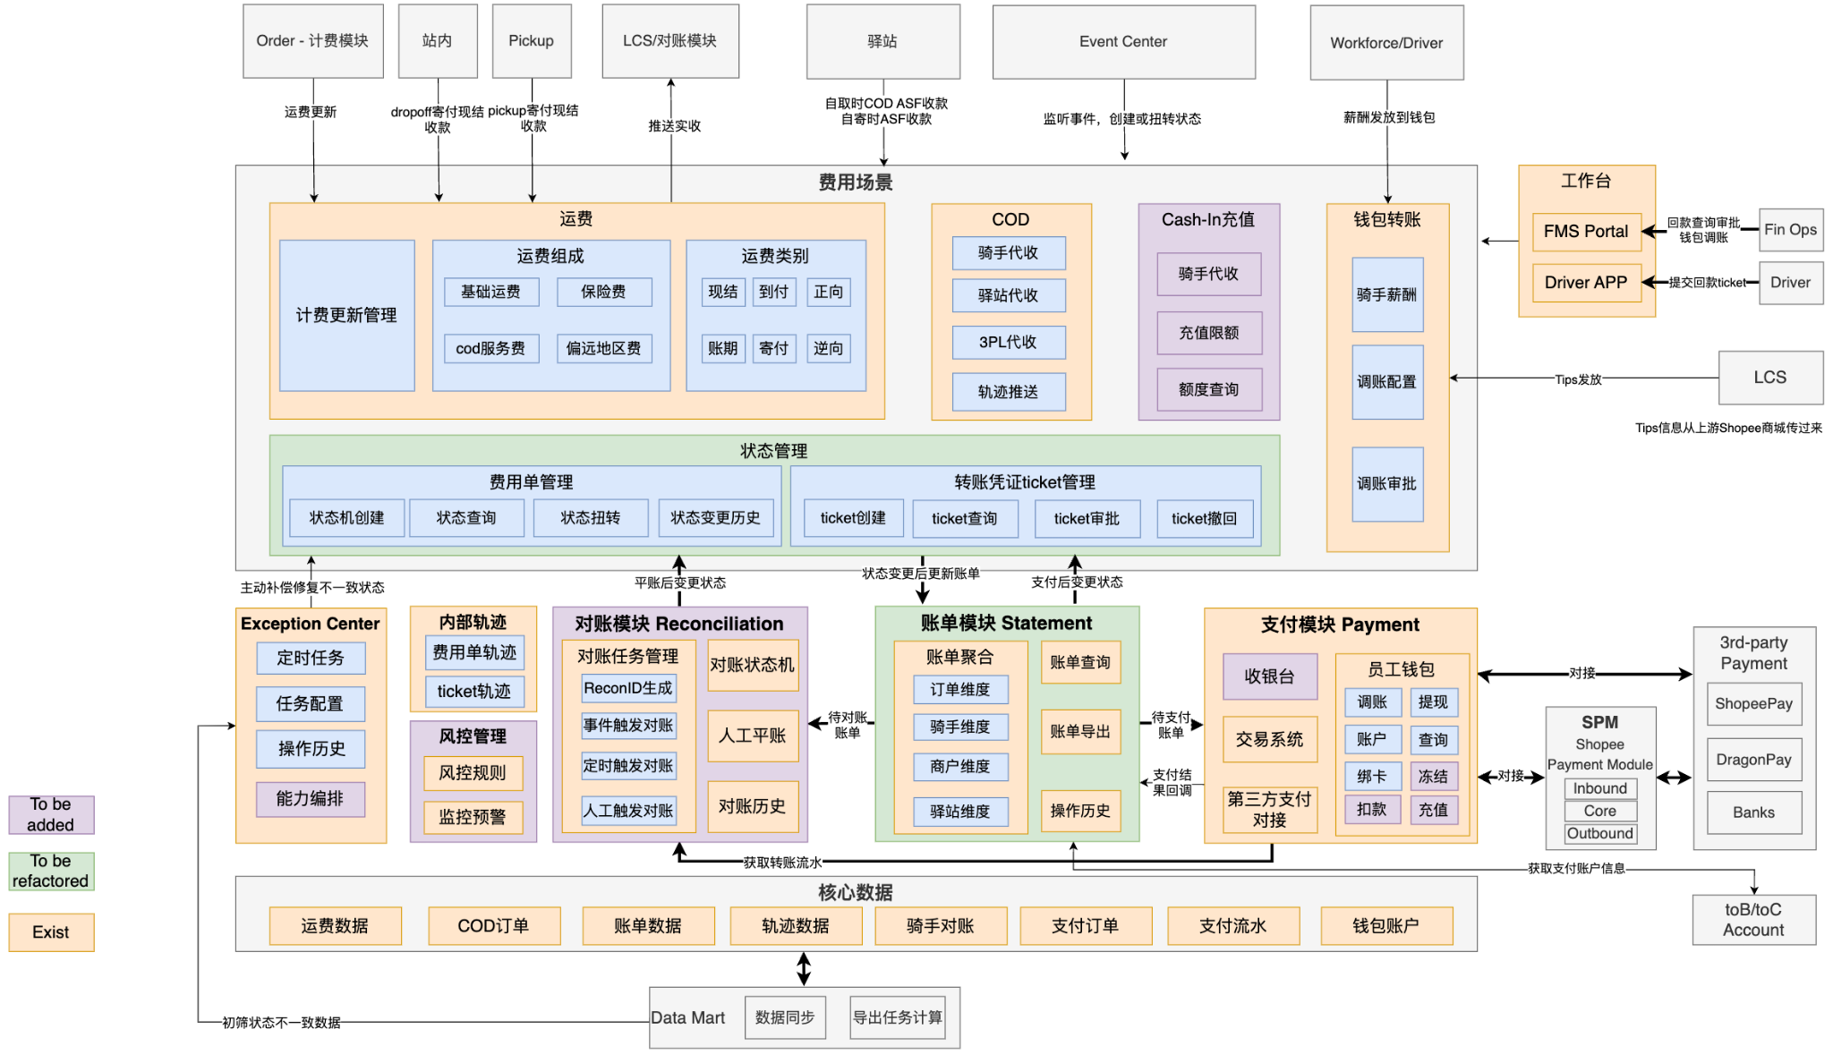
SPX Finance

Slide 38
Agenda
1. SPX Product Architecture Overall
2. SPX Sub Product Architecture
Product & Order
Product
Order (including Tracking)
Network & Dispatch & Exception
Operation
Pickup
In-Station
Line haul
Delivery
Service Point
Locker
Resource Mgmt
Workforce
Asset
Vehicle
Data & Algo
Smart Solution
Data Product
Finance
COD
Basic Service
Account
Notification
Container

Slide 39
SPX Basic (1/3) - Account & Permission
Future Phase
应用层
Web Portal
App
FMS Portal
Service Point Portal
Driver App
SP App
PDA App
Ops App
角色及权限管理
业务身份（Portal）
用户角色（Role）
权限(Permission)
HRIS Account
Admin/HR Ops
FMS/SP Portal
FMS
SP
Admin
Super Admin
鉴权api
Self-Register Account
Non-HR Ops
FMS/SP Portal
PDA/SP App
FM
Hub
SOC
LM
Hub
All Mile
CompanyA
CompanyB
Role-Permisison Relationship
One-Credential
Driver
Driver App
Ops1
Ops2
Ops3
Point1
Point2
Point3
Permisison Mgt
Menu Mgt
WFM-Ops ID
Operator
PDA App
Ops1
Ops2
Ops3
Account Service
Google+SPX Account Service
SEA Account Team Service
Child Account
Ops ID | Link to Parent Account | Individual Staff
One-Credential
ToB Account
Parent Account / HRIS Account System
1:1
HR分配的Google账号
(@shopee;@seamoney)
Other Google账号
(@shopee-external ; @gmail; @Others
ToC Account

Slide 40
SPX Basic (2/3) - Notification
通知中心支持配置通知模版和发送通知以及记录发送结果
支持SP、Delivery等作业域面向seller/buyer/driver发送SMS/WhatsApp通知
发送对象
Seller
Buyer
Driver
Ops
业务域
SP
Pick up
Linehaul
Delivery
……
通知服务
触发条件
通知方式
通知内容
发送日志
Order status
Event
SMS
WhatsApp
Line
Email
Receiver related
Order related
Other
Sent time
Sent result
Notes:
目前情况下各个作业域发email自己部署，没有走noti接口，考虑收敛到noti侧？——bs提供通用能力（linehaul出现过live issue
通知发送监控进展——目前后端已经统计单天的数据发送量级，超出阈值会报警，后续会考虑定期通过email发送给相关方
2023.2.16 Review
1）邮件发送能力放到Q2建设，目前有8个小组使用到此能力
2）增加统计分析板块，如按收件人视角统计、按消息类型统计

Slide 41
SPX Basic (2/3) - Notification
Dispatch/
Event Center
Planning
Notification center
Notification
Monitor
Daily Report｜Dashboard
Sys Auto Trigger
｜Manual Trigger（FE front）
Basic Service
External
System
Rule
Channel
Template
Noti SG
Trigger Rule
Status Change｜Event-receipt
SMS
For Buyer
即将派送｜派送成功｜自取提醒
Push
For Driver
取件任务 | 送件任务
Risk Control Rule
Email
For Seller
即将取货｜派送完成｜订单丢失
In-sys noti
For Ops
盘点通知 | 审批通知
Thrid-part（Whatsapp/Line）
For Agency

Slide 42
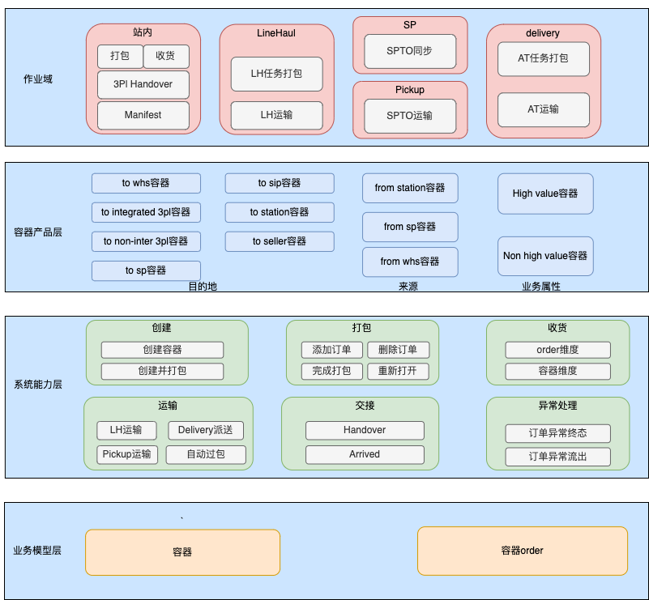
SPX Basic (3/3) - Container

Slide 43
Thank You
Shopee Xpress Product Architecture

Slide 44
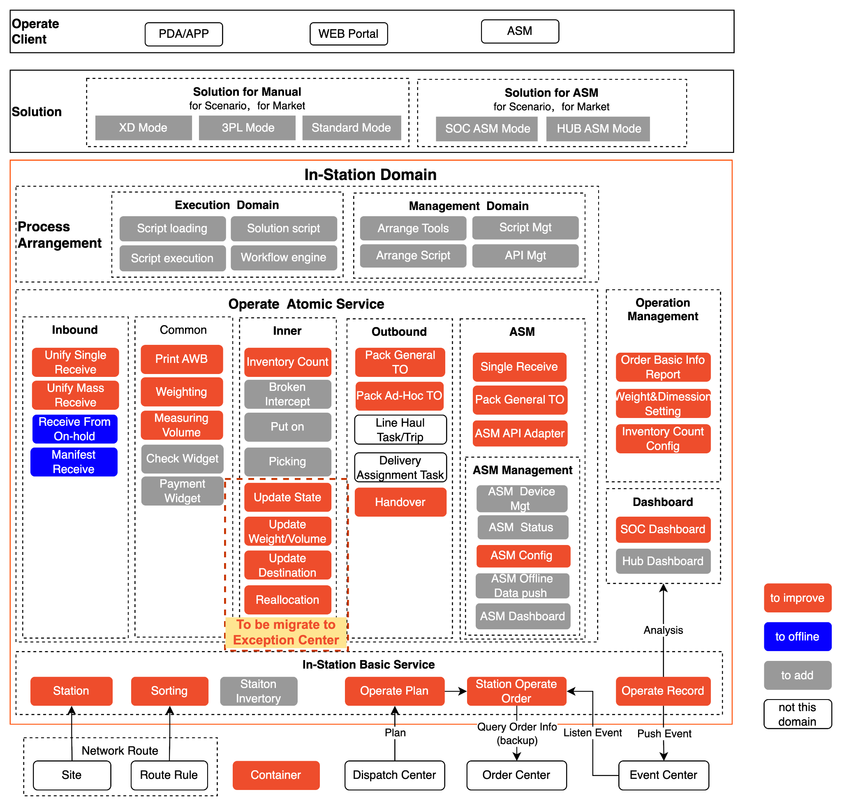
In-Station Business Architecture Overall - In-Station
ASM与在站内域的关系。
对比人工作业，ASM作业需要更强的稳定性与可用性。
ASM需要接入多个供应商提供多种不同的自动化设备。建设标准化的接入API。
ASM与人工线复用原子服务与能力
站内Inner与Exception的关系
In-station建设实操环节的原子能力。比如：贴面单、上下货架。
Exception负责异常业务分析、决策、下发控制。也包含纯异常操作的功能比如：更新状态、拍卖、改地址。
流程编排
提炼标准的原子服务：Receive、Pack、Handover、Weighting、Measure Volume、Print AWB
管理原子能力，并通过编排原子能力去创建流程模板。
给业务更多灵活性，满足不同市场、不同规模、不同流水线的差异。
Notes:
https://app.diagrams.net/#G1PdDtpDheYnuF_Tn-ar3GaTkxtonARzUX
2022.11.10Review记录
重点不紧急：Sorting->Sort Code， 未来动态调度与Sort Code如何协同还需要设计
流程编排层：如果场景有限、update不频繁，流程编排用hardcode方式就可以；是否做成工具和引擎，需要看流程变更频率
站内计划性内容需要预留一个板块来承载
1）时效类：如在什么时间把哪些包裹准备好交给LH，目前这部分还在线下进行，未来可以有LH牵头来做，不过目前业务关注COST，暂时不关注时效，这部分短期还没有启动
2）货量与人力、排班的计划

Slide 45
Business(Product) Architecture (Long term)
In-station Domain
Interface
FMS
PDA
ASM
Process Engine
Dashboard and Report
Flow Configuration
Flow Decision
Task Generator
Task Management
API Management
Data
Operation
Library
Handover Service
Inbound Domain
Inner Domain
Outbound Domain
Instation data
SOC Receive
Measurement
Parcel Sweeper
Put Away
ASM TO Packing
Sorting Service
Hub Receive
Fee Collection
AWB Print
Sorting
TO Packing
Dashboard
ASM Receive
…
Control Panel
…
…
Site Management
SOC live Dashboard
ASM live Dashboard
Atom Service
Library
Validation Atom
Interaction Atom
Service Atom
Market Validation
Market Validation
Banner
SOO Status Update
Order Info Update
Report
Station Validation
Tag Validation
Pop-up
SOO Info Update
Event Monitor
SOC Report
Station Validation
Access Validation
Info Input
Event Pushing
Task Update
ASM Report
In-station Basic
Station Capacity
Plan Management
Task Management
SOO Center
Operation Record
Sorting Plan
Dispatch Center
Event Center
Order Center
WFM
Container
Finance
Other Service

Slide 46
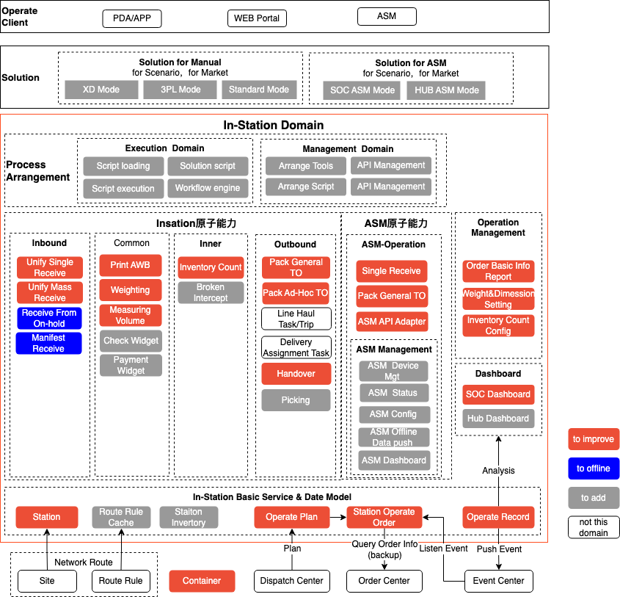
In-Station Business Architecture-Overall
站内解决方案+流程编排
ASM解决方案+流程编排
站内作业原子能力
ASM作业原子能力
+ASM管理原子能力
+系统质量属性保障设计
通用能力建设-待加强
沉淀通用能力，抽象通用服务

Slide 47
Business(Product) Architecture - LH
LinaHaul Domain
Interface
LH Exception 和 Exception Domain的关系
LH Exception的识别完全基于领域内的数据，并在领域内闭环管理。不涉及对外广播交互。
LH Cost 和 Finance 的关系
计费类型打标。例如PH/TH，通过driver属性判断计费类型，同时会对实际作业流有影响。最终确认的计费类型，提供给Finance计费
计费数据审查。例如：监控按重量计费，实际结算重量的合理性。最终可用于计费的结果数据，提供给Finance计费。
计费数据对账，监控传给Finance计费的Trip数据的完整性。
LH Schedule 和 Network 的关系
LH Schedule为运力班次规划，管理实际车辆运行的线路，并不包含线路的属性数据，例如线路的距离、用时、可使用车型等。
Network的LH Route模块（待更名）管理线路的基础属性数据，未来可拓展末端线路属性数据
Network的MM Route模块（待更名）管理order端到端的履约路径，为物流产品时效的定义提供依据
LH Handover 和 in-station的关系
类似于AT和in-station的关系，当前由于部份市场是由driver承担交接的责任，因而将Load/Unload/Seal/Unseal划给了LH。
但从状态机治理来看，LH如果只感知Seal code。handover由in station承接。LH的状态机会更清晰。
LH bidding跟Finance的关系
bidding的对象来自LH Schedule
bidding的结果一方面提供给FInance形成rate card，另一方面提供给LH cost，自动标记Trip的成本类型
PDA
Driver App
FMS Portal
Agency Portal
Scenarios
Dashboard & Report
Long Distance
Milk Run
By Land
By Air
By Sea
SOC-Hub
SOC-SP
SOC-WHS
Dashboard
Operation
Library
Incoming Parcel
LH Schedule
Bidding
Trip Operation
LH Exception
Cost
Intra-day Planning
Schedule Mgt
Invitation of Tender
Assign
Trip Edit
Cost Type Tag
Schedule Recommend
Occasional Trade
Check-in
Security Warning
Data Examination
Report
Auto Adjust Ad-hoc
Space Reservation
Load/Unload
ETA Warning
Data Reconciliation
Agency Performance
Seal/Unseal
Abnormal Trip
Vehicle Cost
Basic
Route Cost
Schedule Version
Bidding Record
Check-in Record
Exception Record
Trip Record
Driver Performance
Handover Record
Notes:
11-17review
vehicle划到General Service，图的呈现再优化下，并且增加车辆网数据接入模块
11-24 review
备注：针对LH丢件场景，ID是由站内装车，LH域只要封条为破损，发生丢件时不负责；在TW，是由LH司机来装车，丢TO时由LH司机负责
很多场景是依赖站内作业人员来装车，波哥建议站内负责此模块
目前没有丢件定责模块，可以思考下放在哪里
车辆空闲、使用状态目前没有，已经成为部分local反馈的痛点，导致两个问题：一是调度中车辆重复，二是部分车辆空闲较严重
梦迪反馈目前fleet与vehicle是两个概念和模块，但璟哥建议只需要一个概念模型，可以去掉fleet概念 @lidong 跟进下

Slide 48
Business(Product) Architecture - Locker
模式
合作租用快递柜
鉴权｜账号｜信息同步｜预定｜webhook
自营快递柜
自取业务
SPX服务
快递柜预定
包裹入柜
包裹超时处理
买家取回
Service Point
Event Service
鉴权
轨迹事件推送
账号服务
柜体服务
格口服务
导出任务
轨迹事件通知
账号管理
信息管理
格口管理
Inventory
Basic Service
信息同步
信息同步
容量管理
存储管理
Point信息
鉴权
Network Route
Workforce
Site服务
Driver管理
设备接入层
地址服务
Dispatch
设备接入
健康检查 ｜ 数据同步
基础信息维护
柜子 ｜ 格口
基础功能支持
开柜 ｜ 格口状态检查
设备监控
设备可用性 ｜ 监控告警
Notes:
2023.2.9 Review
1）建议增加设备可用性、稳定性监控告警能力，提升对终端的感知、管控能力

Slide 49
Network Planning 2: Business(Product) Architecture
Service
末端履约方案
订单路由时效
From — To
Origin Site -> LH Origin Site -> LH Dest Site -> Dest Site
Dest Site -> LH Dest Site -> LH Return Site -> Return Site
Sort Code
Pickup/Deliver/Return
WHS/Locker/SP
Origin Path
Forward/Return
Updated Path
Forward/Return
核心履约站点
Pickup Station / Deliver Station / Return Station / Handover Station / Dispose Station
SLA
时效承诺 / 延误定责 / 动态预警
待新增：
SLA相关，颗粒度为order path级别。规定各个站点间运输的时效要求。末端揽派、站点停留时长则分别取自FM/LM、in_station。 最终Network负责组装运单整体的SLA
路由引擎，动态路由的更新策略
MM Product - 路由产品
版本推荐 — 网络调优、 站点选址
待优化：
Connect config - 多路由配置
版本对外同步、变更提醒
Sorting Plan的加工交接至站内，只保留MM route生成初始版本的逻辑
待移除：
sortcode的管理交接至站内
Basic
网络管理
网络负载监控
网络推荐
网络编辑
网络发布
变更提醒
对外同步
站点/服务范围
负载情况
站点/线路
Serviceable Area
Routing Mgt
Solution计算策略
From-TO/核心履约站点/Sort Code
Connect Config
MM Route(线路配载) / 网络调优
路由最优策略
Origin Path
Updated Path
资源容量
站点/线路
White List
FM: PUP/Shop ID/ WHS
LM: 3PL/Reverse
Address Config
zone ID
lowest Address ID + Sort Code
MM Product
时效/经济 air/sea/land
Route Config
SLA/Type/Distance/Toll/Fuel
Site Mgt
建议
Ad-hoc Trip调整
基础信息管理
物流履约类：All mile Hub/FMHub/SOC/Hub
SP/Locker/PUP/WHS
资产管理类：Asset WHS
业务能力配置
AWB Support
Error Message Config
站点选址
依赖
Address
Smart Sorting
LH
In Station
Workforce
Event
L1-L4
Hub Zone
Schedule / Trip
Capacity
FM Shift
Postcode
货量热力分布
Trip Cost
Efficiency
LM Shift
Notes:
2023.1.12 Review
1）Sort Code ： 站内侧(dongyang+xian.hu) Q1在做这块的演进规划，此规划由站内来主导、Network参与，共同讨论出演进规划和产品方向; 但管理者需要在network这边能看到全局 @dongyang @lidong @xian.hu
2)对于线路资源的容量规划，预测和建议在LH里面体现，network域会监控结果

Slide 50
Network Planning 3: Business(Product) Architecture
Service
末端履约方案
订单路由时效
Order Routing的依赖链路变化
当前都基于静态配置，且配置不支持多路由
未来配置支持多路由，增加策略层做筛选。
以下例子说明： Network 多路由配置和station、LH的关系
From — To
Origin Site -> LH Origin Site -> LH Dest Site -> Dest Site
Dest Site -> LH Dest Site -> LH Return Site -> Return Site
Origin Path
Forward/Return
Updated Path
Forward/Return
核心履约站点
Pickup Station / Deliver Station / Return Station / Handover Station / Dispose Station
SLA
时效承诺 / 延误定责 / 动态预警
Basic
版本管理
网络负载监控
版本推荐
站点选址/网络调优
版本编辑
版本发布
变更提醒
对外同步
站点/服务范围
周末
负载情况
站点/线路
HubB
Serviceable Area
Routing Mgt
Solution计算策略
From-TO/核心履约站点
Connect Config
MM Route(线路配载) / 网络调优
路由最优策略
Origin Path
Updated Path
SOC
HubA
White List
FM: PUP/Shop ID/ WHS
LM: 3PL/Reverse
资源容量
站点/线路
Address Config
zone ID
lowest Address ID
MM Product
时效/经济 air/sea/land
Route Config
SLA/Type/Distance/Toll/Fuel
HubC
Site Mgt
建议
Ad-hoc Trip调整
工作日
基础信息管理
物流履约类：All mile Hub/FMHub/SOC/Hub
SP/Locker/PUP/WHS
资产管理类：Asset WHS
业务能力配置
AWB Support
Error Message Config
…
站点选址
HubB
SOC
依赖
HubC
Address
Smart Sorting
LH
In Station
Workforce
Event
L1-L4
Hub Zone
Schedule / Trip
Capacity
FM Shift
Postcode
货量热力分布
Trip Cost
Efficiency
LM Shift
Notes:
业务场景： 周一到周五 货量够直发， 周末需要经过一次集散， 架构怎么承接这个场景
LH做货量预测，提前做资源规划 -> Network的策略层，origin path考虑LH的计划资源，updated path时会额外考虑LH临时资源。 识别到无直发线路 -> network 提供stowage plan给到站内
网络负载监控里增加 预警，识别到容量不足，提供建议给到LH

Slide 51
Business(Product) Architecture - Exception Monitor
APP
WEB
for Driver&Ops
for BE&FPM&BPM
for Local Team
Business Operation
Exception Center
Exception Monitor
Value-added Services
Exception Handing
Analysis&Metrics
Alarm
Prediction
Aiagnosis
Interception
Fraud | Auction |
Return without relable
Datafix |
Update Address
Exception
Order Halt | Hold on | Not signoff
Alarm by Order
Station Crash
Business Link on Order
Damage | Lost
Aging
Order| Linehaul |OperateDomain
Alarm by Station
Manpower Shortage
Tech Invoke Link on Order
Ticket
Efficiency
Station|Vehicle|Workforce|Driver
Alarm by Human/Vehicle
Vehicle
Shortage
Operate RT
Operation Service Library
Dispatch Center
Event
Center
Order
Center
SSC Data
SSC Algorithm
Exception handling order source
1）Finding from offline
2) Analysis result
To Improve
Building
To Build
Notes:
1）拦截件
-欺诈 UAT
-逆向未重新打印面单 UAT
-拍卖 Auction Dev link
2）异常处理
-Datafix UAT
-Damage | Lost ，To Improve

Slide 52
Express on-the-ground system deployment (long-term)
Last modified: Nov 2022
Partner Integration System
FMS Portal & PDA
In-house Only
Driver App
Both In-house and Partner
Service Point Portal
SP Partner
Devices Integration
(ASM/Locker/Payment Machine)
SLPS Portal
Logistic Partner
Public Network DNS
Route to corresponding servers by URL (different markets and scenarios)
SEA+TW In-house(SG IDC)
LATAM In-house(BR Google Cloud Platform)
LATAM Partner(BR Google Cloud Platform)
General Service
Order Center
Tracking Service
General Service
Order Center
Tracking Service
General Service
Order Center
Tracking Service
Dispatch Center
Event Center
Dispatch Center
Event Center
Dispatch Center
Event Center
Plan
Event
Plan
Event
Plan
Event
Operation Service Library
Operation Service Library
Operation Service Library
Pick-up
In-Station
Pick-up
In-Station
SLPS
Delivery
Linehaul
Delivery
Linehaul
Service Point
Locker
Service Point
Supply chain middleware support(SG IDC)
CAT (monitor)
Apollo (config)
Saturn
Saturn
External
SEA+TW+LATAM Common
LATAM Exclusive

Slide 53
Order Center——Management service around the order whole life cycle
Outside System
Order Center
Event Center
Order Creation
Order Info Mgt
Order Status Mgt
V2/ V3(Open)/ 3-Leg API
Order Basic Info
Status Mgt
SLS
Dispatch Center
Order Creation Validation
Order Operation Info
Status Update Strategy
WMS
3PL Order Creation
Weight Info
3PL
Order Search/Push Service
Finance Info
Order Search API
Operate Domain
Finance
Order Cancel/ Update
Order Cancel/Update Validation
Order Info Update Strategy
Order Push Logic
Pickup
Order Update Strategy
Order Tag Mgt
Basic Info
Operation Validation Tag
Order Finance Mgt
Shipping Fee Calculate
In Station
Order Reroute
Tag Configuration
Serviceable Area
Reroute 4PL Mgt
Fee Mgt
Delivery
Tag Generation Strategy
Order Reroute Update
Exception Tag
LH
Station List
Return
Routing Planing
Order FE
Order Monitoring
Order Tracking List
Order Detail
Order Overview Dashboard
Exception Monitoring
Service Point

Slide 54
Tracking Service & Event Center Architecture
Order Center
Event Center
Operation Service Library
Operation Events Mgmt
Events Notification/Broadcast
Pickup
Dispatch Center
Events Cleaning
In-Station
Linehaul
Outside System
Tracking Service
Service Point
Tracking Display
SLS
Delivery
Tracking Push/Pull API
3PL
Tracking Rule Mgmt
Locker
WMS
Tracking Update Strategy

Slide 55


What’s the Dispatch Center?
I have a plan..
Noted, Sir
The ‘Brain’ of SPX
Dispatch center
Operation Domain
Operation plan generation is based on the information from Tracking & Event Center and Order Center.
Event Center
Order Center
Dispatch Center
All Domains send their operation events to Tracking & Event Center
Dispatch Center is in charge of all the operation plans among stations
The operation plan controlizes cross domain logics
Normal Plan Management
Exception Plan Management
Operation Service Library
Dispatch Center sends operation plan to instruct operation domain actions
All domains are decoupled and there are no direct connection with each other.
Service Point
Locker
In Station
FM/LM
LineHaul
SLPS
Flex

Slide 56
Business(Product) Architecture
LineHaul Domain
Interface
PDA
Driver App
FMS Portal
Agency Portal
Scenarios
Dashboard & Report
Long Distance
Milk Run
By Land
By Air
By Sea
SOC-Hub
SOC-SP
SOC-WHS
Dashboard
Operation
Library
Incoming Parcel
LH Schedule
Bidding
Trip Operation
LH Exception
Cost
Intra-day Planning
Schedule Mgt
Invitation of Tender
Assign
Trip Edit
Cost Type Tag
Schedule Recommend
Occasional Trade
Check-in
Security Warning
Data Examination
Report
Auto Adjust Ad-hoc
Space Reservation
Load/Unload
ETA Warning
Data Reconciliation
Agency Performance
Seal/Unseal
Abnormal Trip
Vehicle Cost
Basic
Route Cost
Schedule Version
Bidding Record
Check-in Record
Exception Record
Trip Record
Handover Record
Driver Performance

Slide 57
New System Structure with Exception Module
How would the system work
Order Center
Explanation for Exception Operation Domain：
Event/Plan: Receive the exception plan in the beginning, and after the exception order update, then send the event to event center.
EO Center: Create exception order (EO) according to the exception plan, update EO state and record operation history.
Operation: Different exception plans and different markets have different SOP. (such as order interception, some markets need relabel, and some don’t need.) This module support user to configure SOP, and help exception order decide which SOP to use.
Ticket Center: Detail on Page 18.
Exception Monitor
Order Processing
Event Monitor
Exception Generator
Exception Dashboard and Notification
Exception request from upstream system.
Exception request from Monitor. System discovers the exception and auto-generate the handling method.
Dispatch Center/Exception
Exception Rule
Plan Management
Event Monitor
Exception request from operation team.
Exception Operation Domain
Ticket Center
Operation
EO Center
Event/Plan
Ticket Creation
SOP Configuration
Exception Order
Plan Mgt
Exception Request
Ticket Management
Operation Service
Operation Record
Event Mgt
Operation Plan
Operation

Slide 58
Architecture
In-station Domain
Interface
FMS
PDA
ASM
Business flow is defined and triggered according to different scenarios.
Flow Engine
Dashboard and Report
Flow Configuration
Flow Decision
Task Generator
Task Management
API Management
Data
Operation
Library
Handover Service
Enter Domain
Inner Domain
Exit Domain
Instation data
Operation would be revamped and be able to be customized according to different business scenarios.
SOC Receive
Measurement
Parcel Sweeper
Put Away
ASM TO Packing
Sorting Service
Hub Receive
Fee Collection
AWB Print
Sorting
TO Packing
Dashboard
ASM Receive
…
Control Panel
…
…
Site Management
SOC live Dashboard
ASM live Dashboard
Atom Service
Library
Validation Atom
Action Atom
Interaction Atom
Atom without business concept would be abstracted and shared to enable efficient business customization and expandization.
Market Validation
Market Validation
SOO Status Update
Get Receiver
Banner
Report
Station Validation
Tag Validation
SOO Info Update
Event Monitor
Pop-up
SOC Report
Station Validation
Access Validation
Event Pushing
Task Update
Info Input
ASM Report
In-station Basic
Station Capacity
Plan Management
Task Management
SOO Center
Operation Record
Sorting Plan
Dispatch Center
Event Center
Order Center
WFM
Container
Finance
Other Service
Notes:
大促和非大促SOP
临时工和正式工
改进点的试错和快速铺开
增值服务、更丰富的快递产品

Slide 59
Business(Product) Architecture
Network
Planning
Order Center
Tracking Service
Dispatch Center
Event Center
FM Business Scenario
Other Operation Service Library
Implant Pickup
(Sea)
Normal Pickup
(Sea + BR)
Rescue Pickup
(Sea)
Merge Pickup and Return
(Sea)
FM Management
FM Operation
FM Monitoring
PUP Group Management
Pickup Route Management
Pickup Wave Management
Ops Pickup Task/Trip Operations
Driver Pickup Operations
Driver Handover Operations
Live Dashboard
Manual Route
Pickup Fail Mgt
Manual Group
Pickup Window
Handover by Task
Routeasy
Manual Task Creation
Sea
Normal Task Auto Accept
Weigh Parcel
Smart Pickup
(Driver Zone)
Pickup Wave
Handover by Order
Inhouse Smart Route
Pickup Task Assignment
Quick Pickup Task
ASF Collection
Handover to Driver
Pickup Point Management
Pickup Trip Assignment
Onhold Pickup Task
Onhold Parcel
BR
Handover to Station
PUP Hierarchy
Pickup Trip Reroute
Pickup Parcel
Pickup Proof
Pickup Task Disable
Handover Onhold
PUP Merge
PUP Distribution
PUP Pickup Timeslot
PUP Pickup
VehicleType
Sea
+BR
Onhold Task Reassignment
Handover
Proof
PUP Creation
Data & Algo & Finance
WFM
General Service
ASF
Shop Info
Existing
Developing
Planning
Notes:
2022-12-08 review
驻场：
后端接口性能、异步任务处理
TO打通，待对齐
暂时不会在Seller进行分拣（是否走虚拟一个SOC的点来集成sorting能力）
波次
timeslot
Quick Pickup
Pickup window时间段与商家可选的时间，目前两者是割裂的，可以讨论下如何打通，提升商家体验
Seller备货数据如何打通？有多种技术方案，如监听面单打印事件
图中两个Proof可以再具体一些
Seller 备货表现
卖家驻场的模式，后续是否会有sorting的诉求（可能需要考虑驻场的卖家占比、单量分布和sorting的诉求，这个可以反馈给BPM，他们来评估下，估计一期不会有，一起更多是跑通链路）；如果后续有，波哥的建议是虚拟一个soc来集成sorting的能力（也就是一个物流PUP同时具备PUP+SOC两个业务属性标签，不同业务属性标签来链接不同的系统能力，例如打TO、分拣等）
直接走quick Pickup而没有走task分配的模式，对整体的数据分析、定责管控、timeslot的管理会有挑战（也就是模式是不是可以统一？如果不能统一，这两种模式是否可以并行，但对于后续这些功能能做比较好的兼容。我个人的建议是，不要为了统一系统而强行改变用户习惯，如果用户quick pickup的作业效率高，那我们就产品适配用户习惯。这个可以和BPM一起讨论下，先不考虑产品先考虑实际场景）
pickup time在官网和实际作业的数据不一致（用户体验不好，这个是个小点，但可以优化；官网虽然流量低，但是门面和口碑的入口，有二级传播效应，所以尽量保持数据一致，这个不紧急）
Seller备货的场景，尽量FM闭环，不建议走Dispatch，这个后面有场景再聊（Dispatch更多调度的是业务模式，pickup更多是管理作业组合，备货的数据信息更多是FM信息处理的事情，和业务模式关系不大）
pickup wave后续的产品优化

Slide 60
Business(Product) Architecture - In-station
Network
Planning
Order Center
Tracking Service
Dispatch Center
Event Center
FM Business Scenario
Other Operation Service Library
Implant Pickup
(Sea)
Normal Pickup
(Sea + BR)
Rescue Pickup
(Sea)
Merge Pickup and Return
(Sea)
FM Management
FM Operation
FM Monitoring
PUP Group Management
Pickup Route Management
Pickup Wave Management
Ops Pickup Task/Trip Operations
Driver Pickup Operations
Driver Handover Operations
Live Dashboard
Manual Route
Pickup Fail Mgt
Manual Group
Pickup Window
Handover by Task
Routeasy
Manual Task Creation
Sea
Normal Task Auto Accept
Weigh Parcel
Smart Pickup
(Driver Zone)
Pickup Wave
Handover by Order
Inhouse Smart Route
Pickup Task Assignment
Quick Pickup Task
ASF Collection
Handover to Driver
Pickup Point Management
Pickup Trip Assignment
Onhold Pickup Task
Onhold Parcel
BR
Handover to Station
PUP Hierarchy
Pickup Trip Reroute
Pickup Parcel
Pickup Proof
Pickup Task Disable
Handover Onhold
PUP Merge
PUP Distribution
PUP Pickup Timeslot
PUP Pickup
VehicleType
Sea
+BR
Onhold Task Reassignment
Handover
Proof
PUP Creation
Data & Algo & Finance
WFM
General Service
ASF
Shop Info
Existing
Developing
Planning
Notes:
2022-12-08 review
驻场：
后端接口性能、异步任务处理
TO打通，待对齐
暂时不会在Seller进行分拣（是否走虚拟一个SOC的点来集成sorting能力）
波次
timeslot
Quick Pickup
Pickup window时间段与商家可选的时间，目前两者是割裂的，可以讨论下如何打通，提升商家体验
Seller备货数据如何打通？有多种技术方案，如监听面单打印事件
图中两个Proof可以再具体一些
Seller 备货表现
卖家驻场的模式，后续是否会有sorting的诉求（可能需要考虑驻场的卖家占比、单量分布和sorting的诉求，这个可以反馈给BPM，他们来评估下，估计一期不会有，一起更多是跑通链路）；如果后续有，波哥的建议是虚拟一个soc来集成sorting的能力（也就是一个物流PUP同时具备PUP+SOC两个业务属性标签，不同业务属性标签来链接不同的系统能力，例如打TO、分拣等）
直接走quick Pickup而没有走task分配的模式，对整体的数据分析、定责管控、timeslot的管理会有挑战（也就是模式是不是可以统一？如果不能统一，这两种模式是否可以并行，但对于后续这些功能能做比较好的兼容。我个人的建议是，不要为了统一系统而强行改变用户习惯，如果用户quick pickup的作业效率高，那我们就产品适配用户习惯。这个可以和BPM一起讨论下，先不考虑产品先考虑实际场景）
pickup time在官网和实际作业的数据不一致（用户体验不好，这个是个小点，但可以优化；官网虽然流量低，但是门面和口碑的入口，有二级传播效应，所以尽量保持数据一致，这个不紧急）
Seller备货的场景，尽量FM闭环，不建议走Dispatch，这个后面有场景再聊（Dispatch更多调度的是业务模式，pickup更多是管理作业组合，备货的数据信息更多是FM信息处理的事情，和业务模式关系不大）
pickup wave后续的产品优化

Slide 61
Business(Product) Architecture - LH
Network
Planning
Order Center
Tracking Service
Dispatch Center
Event Center
FM Business Scenario
Other Operation Service Library
Implant Pickup
(Sea)
Normal Pickup
(Sea + BR)
Rescue Pickup
(Sea)
Merge Pickup and Return
(Sea)
FM Management
FM Operation
FM Monitoring
PUP Group Management
Pickup Route Management
Pickup Wave Management
Ops Pickup Task/Trip Operations
Driver Pickup Operations
Driver Handover Operations
Live Dashboard
Manual Route
Pickup Fail Mgt
Manual Group
Pickup Window
Handover by Task
Routeasy
Manual Task Creation
Sea
Normal Task Auto Accept
Weigh Parcel
Smart Pickup
(Driver Zone)
Pickup Wave
Handover by Order
Inhouse Smart Route
Pickup Task Assignment
Quick Pickup Task
ASF Collection
Handover to Driver
Pickup Point Management
Pickup Trip Assignment
Onhold Pickup Task
Onhold Parcel
BR
Handover to Station
PUP Hierarchy
Pickup Trip Reroute
Pickup Parcel
Pickup Proof
Pickup Task Disable
Handover Onhold
PUP Merge
PUP Distribution
PUP Pickup Timeslot
PUP Pickup
VehicleType
Sea
+BR
Onhold Task Reassignment
Handover
Proof
PUP Creation
Data & Algo & Finance
WFM
General Service
ASF
Shop Info
Existing
Developing
Planning
Notes:
2022-12-08 review
驻场：
后端接口性能、异步任务处理
TO打通，待对齐
暂时不会在Seller进行分拣（是否走虚拟一个SOC的点来集成sorting能力）
波次
timeslot
Quick Pickup
Pickup window时间段与商家可选的时间，目前两者是割裂的，可以讨论下如何打通，提升商家体验
Seller备货数据如何打通？有多种技术方案，如监听面单打印事件
图中两个Proof可以再具体一些
Seller 备货表现
卖家驻场的模式，后续是否会有sorting的诉求（可能需要考虑驻场的卖家占比、单量分布和sorting的诉求，这个可以反馈给BPM，他们来评估下，估计一期不会有，一起更多是跑通链路）；如果后续有，波哥的建议是虚拟一个soc来集成sorting的能力（也就是一个物流PUP同时具备PUP+SOC两个业务属性标签，不同业务属性标签来链接不同的系统能力，例如打TO、分拣等）
直接走quick Pickup而没有走task分配的模式，对整体的数据分析、定责管控、timeslot的管理会有挑战（也就是模式是不是可以统一？如果不能统一，这两种模式是否可以并行，但对于后续这些功能能做比较好的兼容。我个人的建议是，不要为了统一系统而强行改变用户习惯，如果用户quick pickup的作业效率高，那我们就产品适配用户习惯。这个可以和BPM一起讨论下，先不考虑产品先考虑实际场景）
pickup time在官网和实际作业的数据不一致（用户体验不好，这个是个小点，但可以优化；官网虽然流量低，但是门面和口碑的入口，有二级传播效应，所以尽量保持数据一致，这个不紧急）
Seller备货的场景，尽量FM闭环，不建议走Dispatch，这个后面有场景再聊（Dispatch更多调度的是业务模式，pickup更多是管理作业组合，备货的数据信息更多是FM信息处理的事情，和业务模式关系不大）
pickup wave后续的产品优化

Slide 62
关键产品之间的关系 V1.1 (updating)
规划域
订单域
作业域
资金域
COD货款结算
（单商家）
Merchant Fin
Account
Seller Fin
Account
MP Fin
Account
应用层
SPX Open
portal/H5 + ERP + SP
OMS
Shopee Marketplace
卖家物流费用实收
SLS
SPX product | 三段式
Shipping Fee
product+3pl
SSC Fin
Account
Finance Order
Driver
人力规划
SP HeatMap
SP选址逻辑
Order Path
Generation
Order Center
order account
Dispatch
Event
Tracking
物流费用实付
COD
货款
结算
核心
服务
（业务逻辑）
（业务数据）
①FromTo站点
③干线路径
Sorting Rules
FM+LM
MM route
Pickup
Instation
FM/LM Hub | DC
LineHaul
SP&
Locker
Delivery
Service Aera
Network
②二段/三段码
(Smart)
pickup
solution
(Smart)
delivery
solution
SPX Fin Account
Admin Address
与Map数据一致
Smart
Sorting
COD
单订单
Site
SOC, Hub, SP
Line
LH Trips
Pickup
Task
Inbound
Sort/Pack
Line Trips
Task
Inbound/Outbound Task
Delivery Task
Buyer
数据可视化
LH
Driver
Operator
LM
Driver
收款
（现金）
收款
（线上支付）
回款
（线上支付）
数据分析
LM data metrics
业务&产品指标
Forecasting
数据计算
HeatMap
地图可视化
FM pickup
可视化及规则编辑
算法应用
Sorting
Algo
Assignment
Algo
FM
Driver
Operator
SPM
支撑
服务
（基础服务）
最小地图单元
Zone
(Polygon)
Point
基于最小地图单元
业务规则属性(业务PM)
Fleet/Vehicle
Asset
Workforce
identity
Driver
Salary
薪资计算
Driver 2B
Wallet
Driver 2C Wallet
Map Data
(Supply Chain)
Network Data
(Supply Chain)
Order/Operation Data
One Credential（2B/2C Account）
损耗

